Slide 1
CYBERSECURITY
Chhukha Dzongkhag Administration

Slide 2
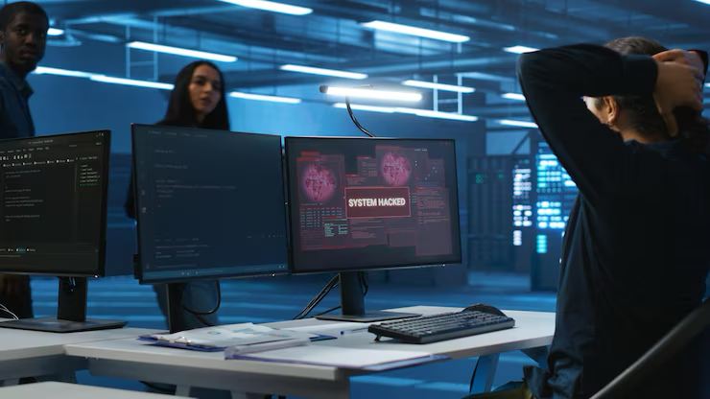
What is Cybersecurity?
Cybersecurity is the practice of protecting computers, networks, devices, programs, and data from unauthorized access, damage, or theft.
It ensures that sensitive information stays confidential, accurate, and available only to those who are authorized.

Slide 3
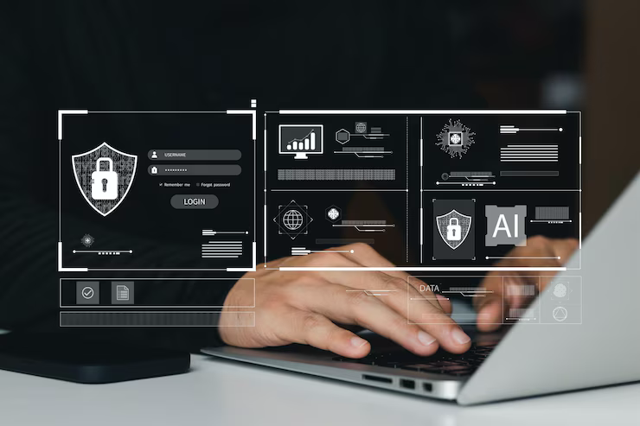
Importance for Administrative Staff
Handling Sensitive Data:
Administrative roles often involve managing confidential information such as employee records.
Financial data.
And communications, making it vital to keep this data secure.(Eg; email)
First Line of Defense:
Administrative employees often act as gatekeepers by controlling access to systems and information.
Spotting suspicious activity early, and preventing cyber incidents.
Maintaining Trust:
Protecting organizational information.

Slide 4
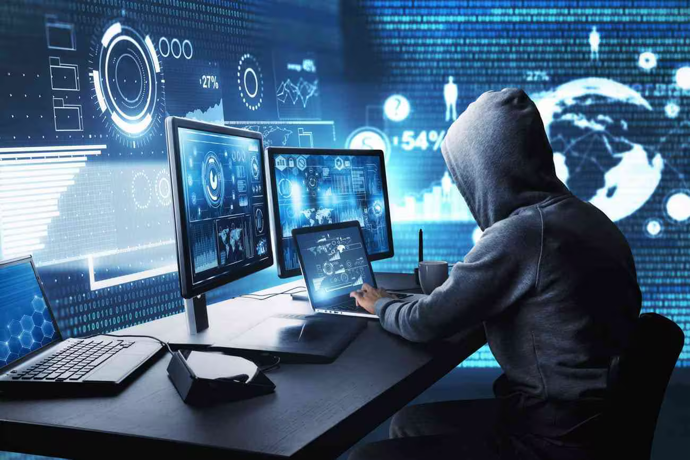
Common Cybersecurity Threats
1. Phishing & Spear Phishing
Phishing: Mass emails or messages that trick you into clicking malicious links or sharing sensitive info like passwords or credit card numbers.
Spear Phishing: Targeted phishing aimed at specific individuals or departments, often using personalized information to appear more convincing.
2. Malware
Viruses: Malicious programs that damage files or systems.
Ransomware: Malware that locks or encrypts your data and demands payment for release.
Spyware: Software that secretly gathers your information without permission.
3. Social Engineering Attacks
Techniques that manipulate people into giving away confidential info or access, such as pretexting, baiting, or tailgating.
4. Password Attacks and Weak Passwords
Password Attacks: Methods like brute force or guessing to break into accounts.
Weak Passwords: Easy-to-guess or reused passwords that increase vulnerability.
5. Insider Threats
Risks from employees or contractors who intentionally or accidentally cause harm by misusing access or data.
6. Physical Security Threats
Theft or loss of devices like laptops, smartphones, or USB drives can expose sensitive data if not properly secured.
Unauthorized physical access to workspaces can lead to data breaches.

Slide 5
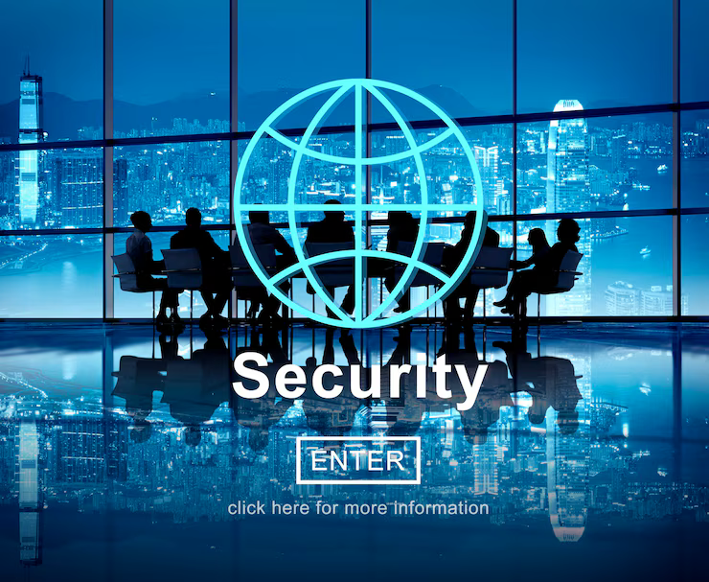
Practical Security Measures for Daily Work
1. Strong Passwords and Password Managers
Use complex passwords with a mix of letters, numbers, and symbols. Avoid using the same password for multiple accounts.
Use a password manager to generate and store unique passwords securely.
2. Multi-Factor Authentication (MFA)
Always enable MFA where available. MFA adds an extra layer of security by requiring a second form of verification (like a code sent to your phone) besides your password.
3. Email and Link Safety: How to Spot Suspicious Emails
Don’t open emails or attachments from unknown senders. Be cautious of urgent requests or threats asking for personal or financial information. Hover over links to check URLs before clicking. Report suspicious emails to your IT or security team.
4. Keeping Software Updated
Regularly update your computer, apps, and antivirus software. Updates fix security vulnerabilities and protect against new threats.
5. Safe Use of Public and Personal Wi-Fi
Avoid accessing sensitive information over public Wi-Fi without a VPN (Virtual Private Network).Use trusted networks and never connect to unsecured or unknown Wi-Fi hotspots.
6. Device Security: Lock Screens, Auto-Timeouts, and Encryption
Always lock your screen when away from your desk. Set devices to automatically lock after a short period of inactivity. Use encryption to protect sensitive data on your devices.

Slide 6
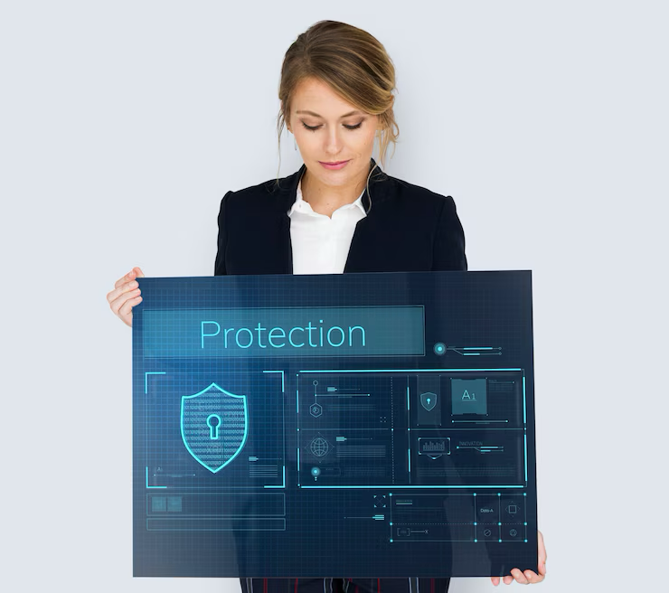
Handling Sensitive Information
1. Data Classification: What is Confidential vs. Public
Confidential Data: Information that must be protected due to legal, privacy, or business reasons. Examples include employee records, financial reports, passwords, and client details.
Public Data: Information approved for sharing with the general public, such as marketing materials or published reports.
2. Secure File Storage and Sharing
Store confidential files in secure, access-controlled locations (e.g., encrypted drives, secure cloud storage).
Use approved methods for sharing sensitive files, like encrypted email or secure file transfer platforms.
Avoid using personal USB drives or unauthorized cloud services.
3. Proper Document Handling (Printing, Shredding, Disposal)
Print confidential documents only when necessary and retrieve them immediately.
Use secure printers or print release systems where possible.
Shred or use secure disposal bins for any sensitive paper documents.
Never discard confidential documents in regular trash.
4. Protecting Personally Identifiable Information (PII)
PII includes data like names, addresses, social security numbers, and phone numbers.
Handle PII carefully to avoid unauthorized access or accidental disclosure.
Follow organizational guidelines for collecting, storing, and sharing PII.

Slide 7
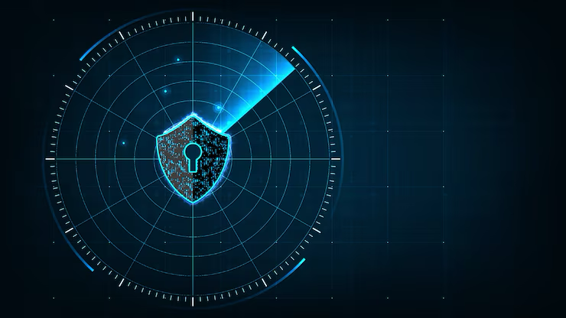
Device and Network Security
1. Secure Use of Mobile Devices
Always lock your phone, tablet, or laptop with a strong password or biometric security (fingerprint, face ID).
Keep your devices updated with the latest software and security patches.
Avoid downloading apps or software from untrusted sources.
Enable device encryption if available to protect data stored on your device.
2. Avoiding Unauthorized USBs and Devices
Never plug in unknown USB drives or external devices—they may contain malware.
Use only organization-approved devices for work purposes.
Report any lost or found devices to IT immediately.
3. VPN Usage for Remote Work
Use a Virtual Private Network (VPN) when accessing organizational systems from outside the office.
VPNs encrypt your internet connection, ensuring data privacy and security over public or untrusted networks.
Always connect to the VPN before accessing work files or emails remotely.
4. Risks of Public Wi-Fi and How to Stay Secure
Public Wi-Fi networks are often unsecured and can be exploited by attackers to intercept data.
Avoid accessing sensitive information or logging into work accounts over public Wi-Fi without a VPN.
If you must use public Wi-Fi, connect through a trusted VPN service and avoid sharing sensitive data.
Turn off automatic Wi-Fi connections to prevent your device from joining unsafe networks unknowingly.

Slide 8
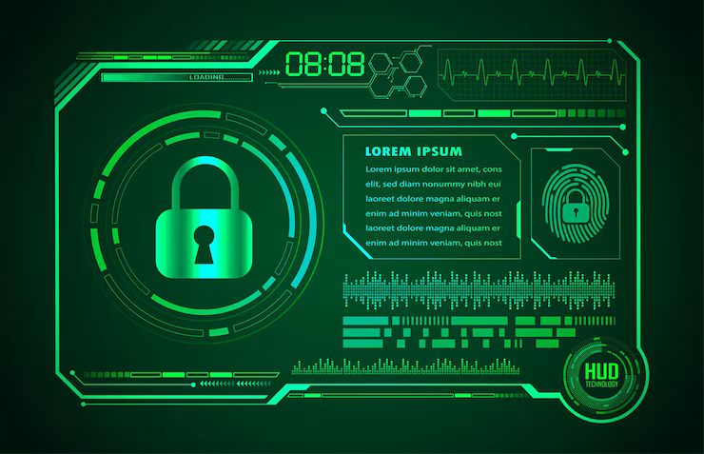
Social Engineering and Insider Threat Awareness
1. What is Social Engineering?
Social engineering is a manipulation technique where attackers trick individuals into revealing confidential information or performing actions that compromise security.
It exploits human psychology rather than technical vulnerabilities.
2. Examples of Social Engineering Attacks
Phishing Emails: Fake emails pretending to be from trusted sources asking for passwords or personal info.
Pretexting: Attackers create a fabricated scenario (e.g., pretending to be IT support) to gain access to sensitive data.
Baiting: Offering something enticing (like free software or a USB drive) to lure victims into a trap.
Tailgating: Following authorized personnel into restricted areas without proper credentials.
3. Recognizing and Reporting Suspicious Behavior
Be cautious of unsolicited requests for sensitive information, urgent demands, or unusual instructions.
Verify identities before sharing any information or granting access.
Report any suspicious calls, emails, or behavior immediately to your security or IT team.
4. How to Protect Yourself from Insider Threats
Insider threats come from employees or contractors who misuse access either intentionally or unintentionally.
Follow the principle of least privilege—only access data needed for your role.
Safeguard your login credentials; never share passwords or access cards.
Report any unusual behavior or policy violations by colleagues promptly.

Slide 9
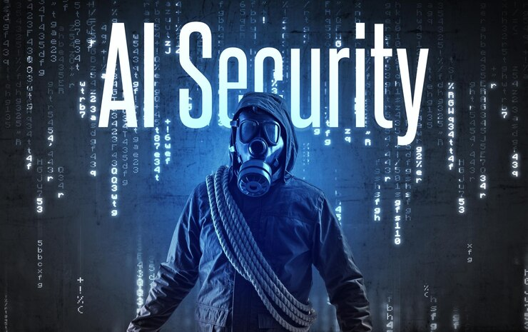
Emerging Cybersecurity Trends
1. Artificial Intelligence (AI) and Machine Learning (ML) in Cyber Defense and Attacks
In Defense: AI and ML help detect unusual patterns and automate threat detection faster than humans. They analyze vast amounts of data to identify cyber threats in real-time.
In Attacks: Cybercriminals use AI to create sophisticated phishing emails, evade detection, and launch automated attacks, making defenses more challenging.
2. Zero Trust Security Model Overview
The Zero Trust model means "never trust, always verify."
Every user or device, inside or outside the network, must be authenticated and authorized before accessing resources.
This reduces risk from compromised accounts or devices by limiting access strictly to what is necessary.
3. Cloud Security Basics
More organizations use cloud services to store data and run applications.
Cloud security focuses on protecting data and systems in the cloud from breaches, misconfigurations, and unauthorized access.
Staff should use strong passwords, enable multi-factor authentication, and be cautious with sharing cloud-based files.
4. Internet of Things (IoT) Security Risks
IoT devices include smart printers, cameras, and sensors connected to the network.
These devices can be weak points for cyberattacks if not properly secured.
Always follow guidelines to secure IoT devices, including updating firmware and changing default passwords.
5. Cybersecurity in Remote and Hybrid Work Environments
Remote work increases reliance on personal devices and home networks, which may be less secure.
Use VPNs, secure Wi-Fi, and company-approved devices for work.
Be extra vigilant about phishing scams and social engineering attacks targeting remote workers.

Slide 10
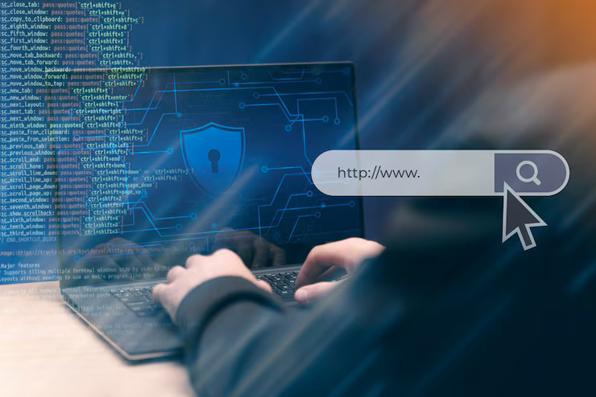
Personal Cyber Hygiene
1. Using Personal Devices Safely for Work
Keep devices updated with the latest security patches and antivirus software.
Enable screen locks and automatic timeout features.
Separate personal and work data when possible—use secure apps and organizational platforms for work tasks.
Use VPNs when accessing company systems remotely.
2. Avoiding Oversharing on Social Media
Don’t post personal details like your full name, address, workplace, or daily routines.
Avoid sharing work-related info or photos that reveal confidential data.
Be cautious of social engineering—cybercriminals often use public profiles to tailor phishing attacks.
3. Protecting Personal Accounts from Being Compromised
Use unique, strong passwords for each account (consider a password manager).
Enable multi-factor authentication (MFA) wherever possible.
Monitor account activity for unusual logins or password change requests.
Be wary of phishing emails and fake login pages that mimic real sites.
4. Best Practices for Safe Internet Browsing
Avoid clicking on ads, pop-ups, or suspicious links.
Use a secure, updated browser and install browser-based security add-ons.
Only download software from official or trusted sources.
Look for HTTPS in the address bar before entering any sensitive information.

Slide 11
✅ Conclusion and Call to Action
🔁 Recap of Key Takeaways
Cybersecurity is everyone’s responsibility—not just the IT department’s.
Common threats include phishing, malware, weak passwords, social engineering, and insider risks.
Protective measures like strong passwords, MFA, secure Wi-Fi, regular updates, and proper data handling are essential.
Always report suspicious behavior or incidents promptly to IT/security teams.
👥 Your Role in Protecting the Organization
Be cautious and follow best practices in your day-to-day work.
Handle sensitive data responsibly and securely.
Stay informed and engaged—your awareness can prevent costly security breaches.
👀 Stay Vigilant and Proactive
Cyber threats evolve constantly.
Question unexpected emails, links, and requests for information.
Never assume safety—verify before you trust.
🛠️ Resources and Support Available
Contact your IT Helpdesk or Security Team for any issues or questions.
Refer to your organization’s Cybersecurity Policy for guidelines.
Use internal training portals or security awareness materials shared by your organization.

